Slide 1

Coursera Capstone Projects - The Battle of Neighborhoods
Child Care in Toronto
Table of contents
Introduction: Business Problem
Approach to Solve The Issue
Description of the data
Methodology
Analysis
Results and Discussion
Conclusion
1. Introduction/Business Problem
The Approach I used to begin this Project is by searching through the web to takle major issues facing residence of Toronto, especially families which having working parents. As I research through this problem, The Canadian daycare market has a well- established surplus of demand, resulting in anxiety-inducing waitlists — joined as early as the day a couple learns they’re expecting
— and monthly fees that can amount to more than a mortgage payment. “It’s worse than finding a house or looking for an apartment.
Daycare fees continue to rise across Canada
In the study, child care is divided into three categories – infant, toddler,preschooler, Kindergarten, and Gradelevel. The researchers define these categories as birth to two years for infants, 18 months to three years for toddlers, and two-and-a-half years to kindergarten age for preschoolers, which is age four or five, depending on the province.
These categories often see wildly different prices for full-time care, as a result of the smaller number of facilities available for infants, as well as the higher ratio of caregivers to children required by law. This means that while preschool age child care tends to be a lower figure overall, it gives the best idea of what the average family pays, since half of children in child care centres in Canada fall into this category.
The waitlist problem
But costs can be only half the battle for families when it comes to child care. The demand for child care greatly surpasses availability in most cases.
Researchers found that in almost three-quarters of the cities covered in the study, centres maintained lengthy waitlists of children waiting to enter care programs. Bigger cities see 80 to 90 per cent of centres maintaining a waitlist, while even smaller cities like St. John’s are in the 79 per cent range.
Wait lists are one of the major hurdles keeping parents from accessing quality child care, with families having to start the process early if they want to get their child enrolled. “You have to apply basically while you’re pregnant !!!
Source: https://www.ctvnews.ca/features/analysis-daycare-fees-continue-to-rise-across-canada-1.3940099
2. Approach to Solve The Issue
Help Individual (Parents) to find best Daycare Center for their child that match thier criteria.
Encourage Business owners to invest in such high demand business by leveraging them with the best location.
Benefits of growth of this business can be highly apprecaited by individuals and business owners. some are listed below:
by relieving parents from lengthy wait list.
cost reduction.
Good investment for Business owners as the subject is in High demand.

Slide 2
3. Description of the data
Data Collection
Licensed Day Care Centres (https://github.com/mkorogluNYC/NYC_Data_ScienceAcademy/blob/master/Shiny_project/toronto_cc.csv#L1008)
The venues in each neighborhood. (FourSquare API)
Postal codes in Toronto (https://en.wikipedia.org/wiki/List_of_postal_codes_of_Canada:_M)
Toronto geospatial data (https://cocl.us/Geospatial_data)
II. Data Importing
In [2]:
Out[2]:
Postcode | Borough | Neighbourhood
0 M1A | Not assigned | Not assigned
1 M2A | Not assigned | Not assigned
2 M3A | North York | Parkwoods
3 M4A | North York | Victoria Village
4
M5A
Downtown Toronto
Harbourfront
In [7]:
Out[7]:
Unnamed:
0
Unnamed:
1
loc_id
name
type
str_no
street
postal_code
ward
phone
building.type
bldgname
Infant
0
NaN
1 1013
Lakeshore Community Child Care
Centre
Non- seventh 416-394-
Profit ¹⁰¹ st ^{M8V 3B5 6} 7601
Public Elementary
School
Seventh Street Public School
0
1
NaN
2 1014
Alternative Primary School Parent
Group
Non- Profit
1100
spadina
rd
M5N 2M6
16
416-322-
5385
Public Elementary
School
North Preparatory
Public School
0
2
NaN
3 1015
Cardinal Leger Child Care Centre (Scarborough)
Non- morrish 416-287-
Profit ⁶⁰⁰ rd ^{M1C 4Y1 44} 0578
Catholic Elementary
School
Cardinal Leger Catholic School
0
George Brown
3 | NaN | 4 | 1016 | - Richmond Adelaide
 |  |  |  | Childcare Centre
4 | NaN | 5 | 1017 | Woodland Nursery
 |  |  |  | School
Non- Profit
130
adelaide
st w
M5H 3P5
28
416-415-
2453
Other
NaN
10
Non- Profit
1
firvalley
crt
M1L 1N8
416-694-
High Rise Apartment
NaN
0
³⁵ 1138x151
III. Data Cleaning & Processing
In [9]:
#lets examine total number of childern enrolled on those centers

Slide 3
child_center['Total'].sum()
Out[9]: 68763
In [10]:
Out[10]:
loc_id
name
type
str_no
street
postal_code
ward
phone
building.type
bldgname
Infant
Toddler
Preschooler
0 1013
Lakeshore Community Child Care
Centre
Non- seventh 416-394-
Profit ¹⁰¹ st ^{M8V 3B5 6} 7601
Public Elementary
School
Seventh Street Public School
0
20
32
1 1014
Alternative Primary School Parent
Group
Non- Profit
1100
spadina
rd
M5N 2M6
16
416-322-
5385
Public Elementary
School
North Preparatory
Public School
0
0
12
2 1015
Cardinal Leger Child Care Centre (Scarborough)
Non- Profit
600
morrish
rd
M1C 4Y1
44
416-287-
0578
Catholic Elementary
School
Cardinal Leger Catholic School
0
10
16
3 1016
George Brown
- Richmond Adelaide Childcare Centre
Non- Profit
130
adelaide
st w
M5H 3P5
28
416-415-
2453
Other
NaN
10
15
40
4 1017
Woodland Nursery School
Non- Profit
1
firvalley
crt
M1L 1N8
416-694-
High Rise Apartment
NaN
0
10
0
³⁵ 1138x151
4. Methodology
Child care cost is one of the key component of expenses of a family. It becomes more crucial for families, where each parent is not available to take care of their child and cannot afford to pay the full amount of the child care tuition. Child care fee subsidy in Canada is the main child care financing of each province introduced in the Canada Assistance Plan in 1972. Eligible families pay the child care cost depending on the income level. Certain conditions in terms of unavailability of each parent are listed in City of Toronto's website as the following.
Each parent is either:
employed, looking for work,
in school or planning to go to school, or if their child has a special need.
Eligible income range for child care fee subsidy in the City of Toronto is up to $73,000. Families with lower income ranges are eligible for larger amount of fee subsidy. This project aims to visualize the effectiveness of child care fee subsidy using dataset from the City of Toronto open data catalogue. The project has three purposes. First, the user can find the child care centre depending on his or her preferences on the location, subsidy choice, and the type of child care centre. Second, child care centres can be listed through the data clustering map, where the user can filter the results based on the location, subsidy, and type of child care centre choice. Finally, key insights from the dataset are provided to make the decision on how effective the fee subsidy program in the City of Toronto is at policy level.
5. Analysis
Out[11]:
name subsidy
type
Borough loc_id ward Infant Toddler Preschooler Kindergarten Gradelevel Total gc_geoid

Slide 4
n_{A}a&m_{A}e |  | subsidy | type | Borough | loc_id | ward | Infant | Toddler | Preschooler | Kindergarten | Gradelevel | Total | gc_geoid
0 | Child Care Centre | Yes | Non-Profit | Scarborough | 1288 | 41 | 20 | 25 | 48 | 0 | 45 | 138 | 2834434
1
A B C Day Nursery
Yes Commercial North York 1036
15
10
15
16
20
25
86
67882
A Place To
Play Nursery School Of Bloor West
V...
Etobicoke
York
2
No Non-Profit
6632 13
0
0
16
0
0 16 7985487
Abacus Day Care Centre (629735
Ontario Inc.)
3
Yes Commercial Scarborough
1301
40
0
10
24
0
0
34
319578
4
Abacus Montessori Learning Centre
No Commercial North York 9995 34
0
15
48
0
0 63 504128
In [12]:
#lets see how many centers provide fee_subsidy in Toronto
Out[12]:
fee_subsidy
Yes No
677
330
dtype: int64
In [13]:
child_center.describe()
Out[13]:
 | loc_id | ward | Infant | Toddler | Preschooler | Kindergarten | Gradelevel | Total | gc_geoid | lo
count | 1007.000000 | 1007.000000 | 1007.000000 | 1007.000000 | 1007.000000 | 1007.000000 | 1007.000000 | 1007.000000 | 1.007000e+03 | 1007
mean | 6878.050645 | 22.650447 | 3.464747 | 9.788481 | 22.910626 | 12.385303 | 19.735849 | 68.285005 | 6.099534e+06 | -79
std | 4719.244161 | 12.133328 | 5.967315 | 9.937576 | 17.022788 | 17.797639 | 26.052053 | 41.821418 | 6.010884e+06 | 0
min | 1013.000000 | 1.000000 | 0.000000 | 0.000000 | 0.000000 | 0.000000 | 0.000000 | 8.000000 | 1.759900e+04 | -79
25% | 1775.500000 | 13.000000 | 0.000000 | 0.000000 | 16.000000 | 0.000000 | 0.000000 | 39.000000 | 5.759305e+05 | -79
50% | 6551.000000 | 23.000000 | 0.000000 | 10.000000 | 24.000000 | 0.000000 | 0.000000 | 57.000000 | 6.355204e+06 | -79
75% | 12064.000000 | 32.000000 | 10.000000 | 15.000000 | 32.000000 | 26.000000 | 30.000000 | 88.000000 | 9.538058e+06 | -79
max | 13564.000000 | 44.000000 | 30.000000 | 56.000000 | 204.000000 | 100.000000 | 144.000000 | 280.000000 | 3.007298e+07 | -79
In [14]:
#lets see how many categories of child care centers and how many center in each category
Out[14]: center_type
Non-Profit | 668
Commercial | 286
City-Operated | 53
dtype: int64
According to our data for the Liscensed child care center in Toronto, we found that:
Non-Profit centers = 668
Commercial Centers = 286
City operated centers = 53

Slide 5
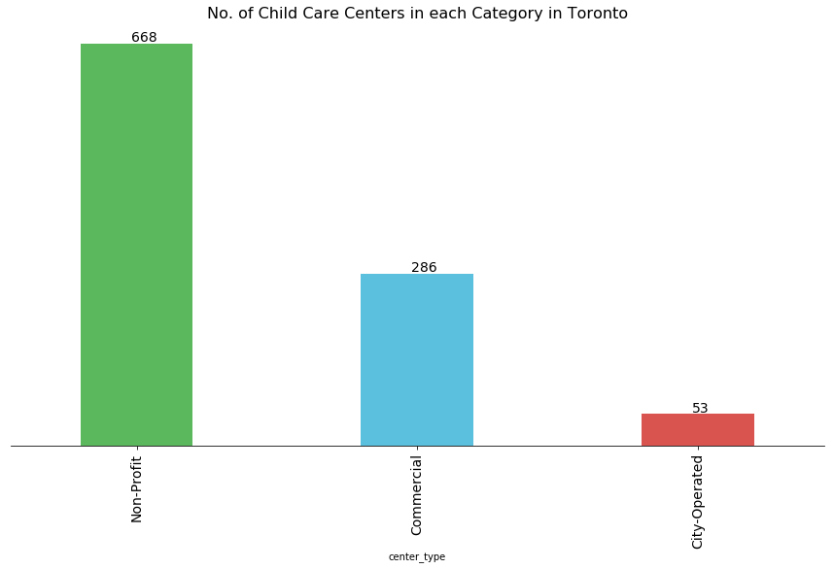
In [16]:
#lets see how many child care centers in each Borough
Out[16]: Borough Toronto East York | 318
North York | 266
Etobicoke York | 226
Scarborough | 197
Name: Borough, dtype: int64
According to our data for the Liscensed child care center in Toronto again, we found that:
child care centers in Toronto East York = 318
child care centers in North York = 266
child care centers in Etobicoke York = 226
child care centers in Scarborough = 197
In [17]:

Slide 6
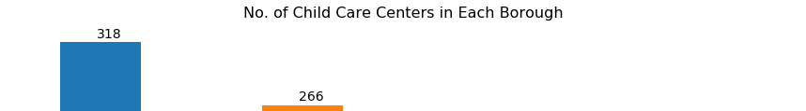
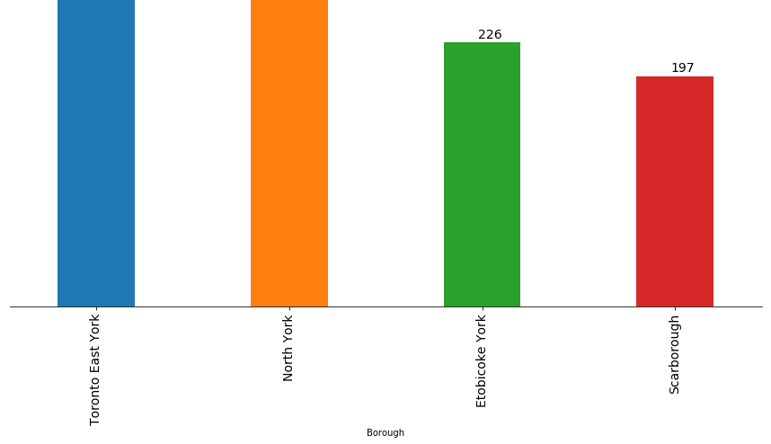
In [18]:
# lets see child distribution among each categories in each Bourough
Out[18]:
Borough | subsidy | type | Infant | Toddler | Preschooler | Kindergarten | Gradelevel | Total
0 Etobicoke York | No | Commercial | 165 | 539 | 1327 | 209 | 402 | 2642
1 Etobicoke York | No | Non-Profit | 20 | 109 | 556 | 15 | 208 | 908
2 Etobicoke York | Yes | City-Operated | 126 | 205 | 312 | 62 | 74 | 779
3 Etobicoke York | Yes | Commercial | 116 | 275 | 633 | 248 | 459 | 1731
4 Etobicoke York | Yes | Non-Profit | 306 | 770 | 1562 | 2334 | 3909 | 8881
In [20]:
Out[20]: type City-Operated | subsidy Borough Yes Etobicoke York | 779
 | North York | 471
 | Scarborough | 597
 | Toronto East York | 815
Commercial | No Etobicoke York | 2642
 | North York | 2866
 | Scarborough | 1009
 | Toronto East York | 3652
 | Yes Etobicoke York | 1731
 | North York | 2218
 | Scarborough | 2559
 | Toronto East York | 553
Non-Profit | No Etobicoke York | 908
 | North York | 1995
 | Scarborough | 933
 | Toronto East York | 2004
 | Yes Etobicoke York | 8881
 | North York | 11795
 | Scarborough | 6644
 | Toronto East York | 15711
Name: Total, | dtype: int64

Slide 7
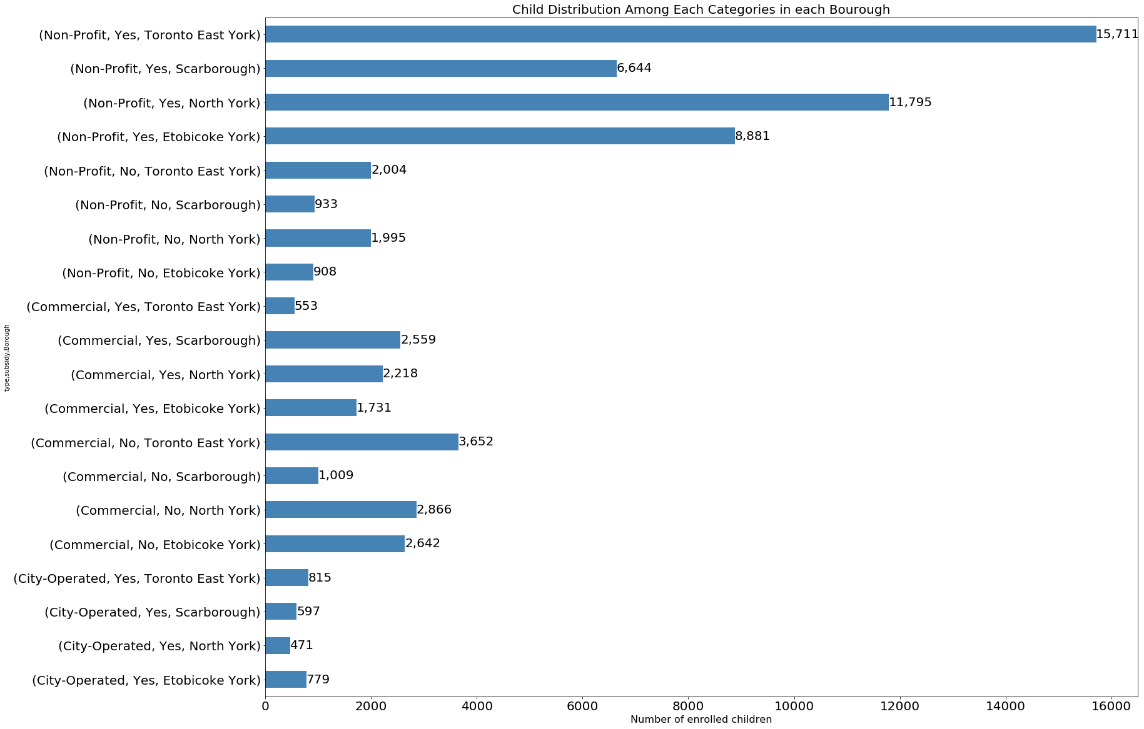
From above dataframe, we noticed that all city operated centers are eligible for fee subsidy. In contrast, commercial & Non- profit centers are eligible for both. Now, lets visualize number of children enrolled in each categories in each
Borough
In [28]:
In [29]:
Out[29]:
Borough | type | Infant | Toddler | Preschooler | Kindergarten | Gradelevel | Total
0 Etobicoke York | City-Operated | 126 | 205 | 312 | 62 | 74 | 779
1 Etobicoke York | Commercial | 281 | 814 | 1960 | 457 | 861 | 4373
2 Etobicoke York | Non-Profit | 326 | 879 | 2118 | 2349 | 4117 | 9789
3 North York | City-Operated | 46 | 75 | 152 | 80 | 118 | 471
4 North York | Commercial | 371 | 1206 | 2646 | 305 | 556 | 5084
5 North York | Non-Profit | 422 | 1588 | 4034 | 2895 | 4851 | 13790
6 Scarborough | City-Operated | 76 | 145 | 224 | 98 | 54 | 597
7 Scarborough | Commercial | 251 | 658 | 1669 | 227 | 763 | 3568
8 Scarborough | Non-Profit | 371 | 938 | 2118 | 1644 | 2506 | 7577
9 Toronto East York | City-Operated | 110 | 180 | 280 | 100 | 145 | 815
10 Toronto East York | Commercial | 434 | 1074 | 2226 | 272 | 199 | 4205
11 Toronto East York | Non-Profit | 675 | 2095 | 5332 | 3983 | 5630 | 17715
In [34]:
df_grp2.type # returns a series

Slide 8
Out[34]:
0
1
2
3
4
5
6
7
8
9
10
11
City-Operated Commercial Non-Profit City-Operated Commercial Non-Profit City-Operated Commercial Non-Profit City-Operated Commercial Non-Profit
Name: type, dtype: object
In [35]:
Out[35]:
type | Borough | Infant | Toddler | Preschooler | Kindergarten | Gradelevel | Total
City-Operated | Etobicoke York | 126 | 205 | 312 | 62 | 74 | 779
Commercial | Etobicoke York | 281 | 814 | 1960 | 457 | 861 | 4373
Non-Profit | Etobicoke York | 326 | 879 | 2118 | 2349 | 4117 | 9789
City-Operated | North York | 46 | 75 | 152 | 80 | 118 | 471
Commercial | North York | 371 | 1206 | 2646 | 305 | 556 | 5084
Non-Profit | North York | 422 | 1588 | 4034 | 2895 | 4851 | 13790
City-Operated | Scarborough | 76 | 145 | 224 | 98 | 54 | 597
Commercial | Scarborough | 251 | 658 | 1669 | 227 | 763 | 3568
Non-Profit | Scarborough | 371 | 938 | 2118 | 1644 | 2506 | 7577
City-Operated | Toronto East York | 110 | 180 | 280 | 100 | 145 | 815
Commercial | Toronto East York | 434 | 1074 | 2226 | 272 | 199 | 4205
Non-Profit | Toronto East York | 675 | 2095 | 5332 | 3983 | 5630 | 17715
city operated centers
lets see what is the total number of children in city_operated centers in Toronto
In [36]:
Out[36]:
Infant Borough | Toddler | Preschooler | Kindergarten | Gradelevel | Total
Etobicoke York 126 | 205 | 312 | 62 | 74 | 779
North York 46 | 75 | 152 | 80 | 118 | 471
Scarborough 76 | 145 | 224 | 98 | 54 | 597
Toronto East ₁₁₀ | 180 | 280 | 100 | 145 | 815
York
In [37]:
# lets see what is the total number of children in city_operated centers in Toronto
Out[37]:

Slide 9
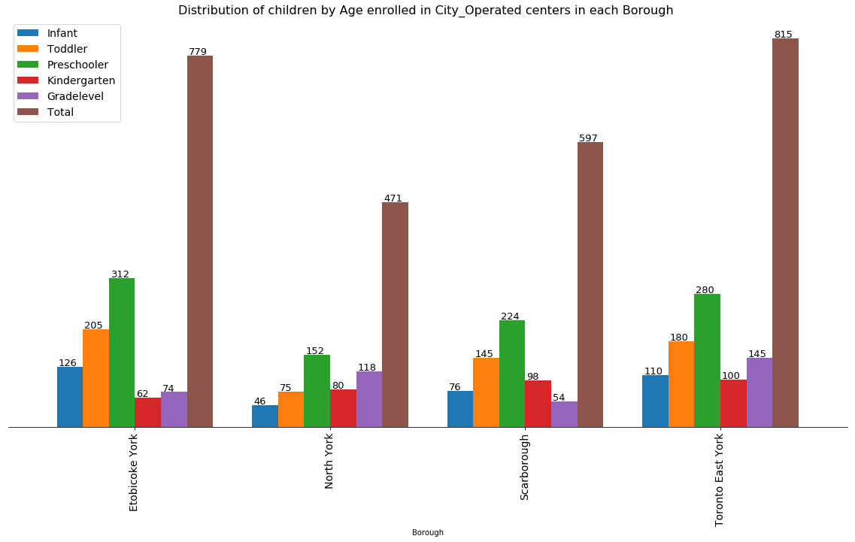
2662
In [45]:
Commercial centers
lets see what is the total number of children in Commercial centers in Toronto
In [40]:
Out[40]:
Infant Borough | Toddler | Preschooler | Kindergarten | Gradelevel | Total
Etobicoke York 281 | 814 | 1960 | 457 | 861 | 4373
North York 371 | 1206 | 2646 | 305 | 556 | 5084
Scarborough 251 | 658 | 1669 | 227 | 763 | 3568
Toronto East ₄₃₄ | 1074 | 2226 | 272 | 199 | 4205
York
In [41]:
# lets see what is the total number of children in commercial centers in Toronto
Out[41]: 17230
In [44]:

Slide 10
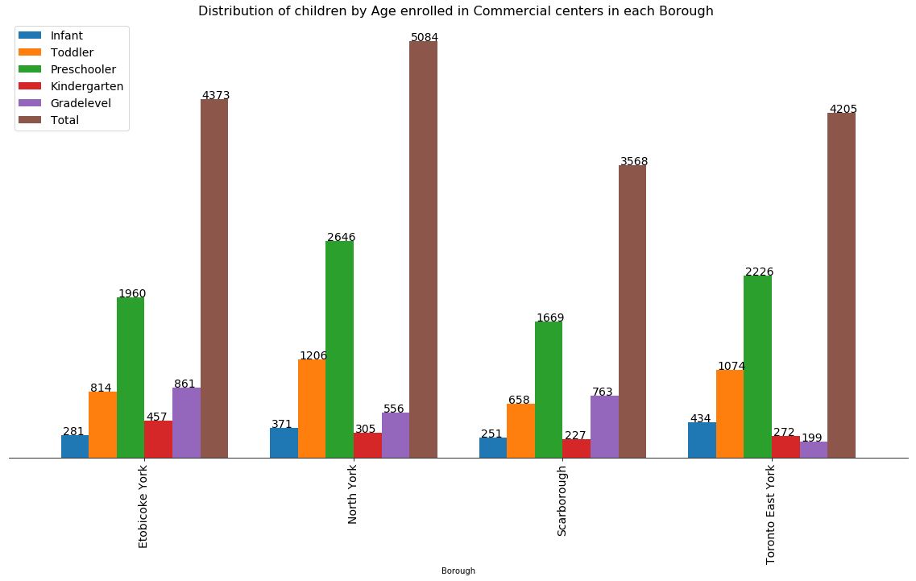
Non-profit centers
lets see what is the total number of children in Non-profit centers in Toronto
In [46]:
Out[46]:
Infant Borough | Toddler | Preschooler | Kindergarten | Gradelevel | Total
Etobicoke York 326 | 879 | 2118 | 2349 | 4117 | 9789
North York 422 | 1588 | 4034 | 2895 | 4851 | 13790
Scarborough 371 | 938 | 2118 | 1644 | 2506 | 7577
Toronto East ₆₇₅ | 2095 | 5332 | 3983 | 5630 | 17715
York
In [47]:
# lets see what is the total number of children in Non-Profit centers in Toronto
Out[47]: 48871
In [48]:

Slide 11

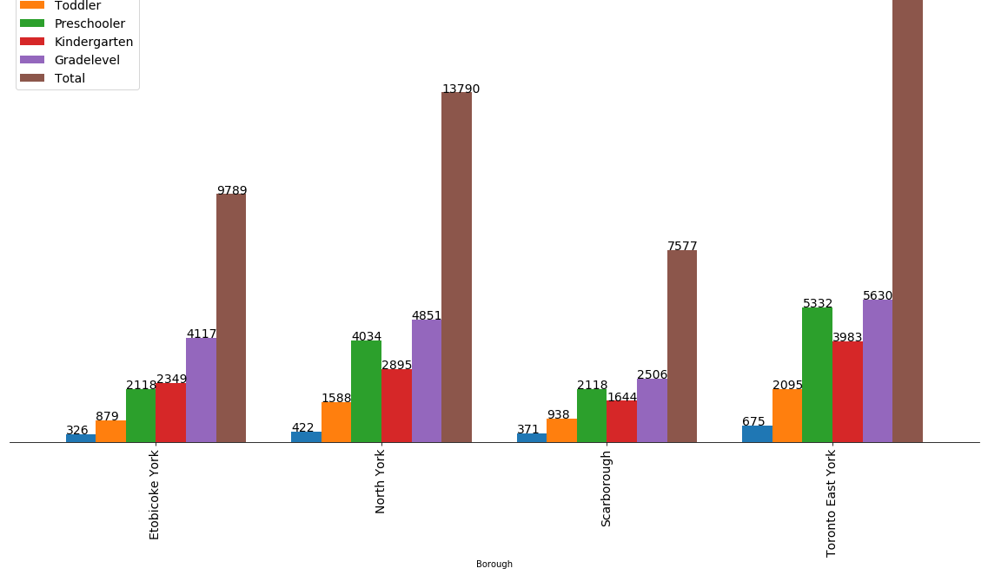
In [49]:
Percentage of child enrolled in Non-profit centers = 71.07165190582144% Percentage of child enrolled in Commercial centers = 25.057080115759927% Percentage of child enrolled in City-Operated centers = 3.8712679784186266%
In [51]:
Out[51]:
loc_id
name
type
str_no
street
postal_code
ward
phone
building.type
bldgname
Infant
Toddler
Preschooler
0 1013
Lakeshore Community Child Care
Centre
Non- seventh 416-394-
Profit ¹⁰¹ st ^{M8V 3B5 6} 7601
Public Elementary
School
Seventh Street Public School
0
20
32
1 1014
Alternative Primary School Parent
Group
Non- Profit
1100
spadina
rd
M5N 2M6
16
416-322-
5385
Public Elementary
School
North Preparatory
Public School
0
0
12
2 1015
Cardinal Leger Child Care Centre (Scarborough)
Non- Profit
600
morrish
rd
M1C 4Y1
44
416-287-
0578
Catholic Elementary
School
Cardinal Leger Catholic School
0
10
16
3 1016
George Brown
- Richmond Adelaide Childcare Centre
Non- Profit
130
adelaide
st w
M5H 3P5
28
416-415-
2453
Other
NaN
10
15
40
4 1017
Woodland Nursery School
Non- Profit
1
firvalley
crt
M1L 1N8
416-694-
High Rise Apartment
NaN
0
10
0
³⁵ 1138x151
Exploring and clustering neighborhoods in Toronto.
In [54]:
# Use geopy library to get the latitude and longitude values of Toronto

Slide 12
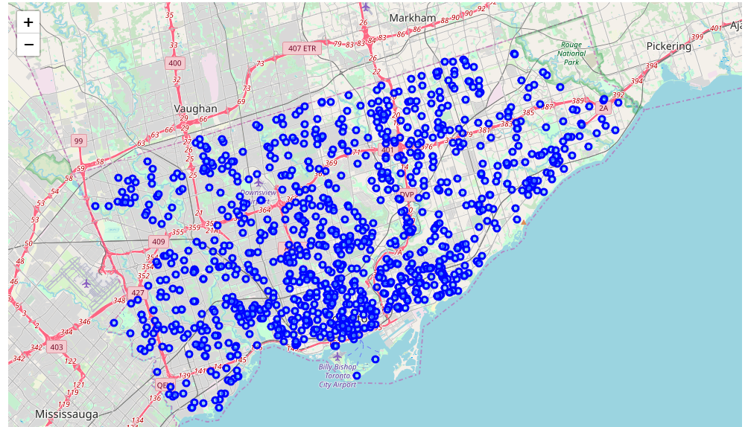
address = 'Toronto, Ontario Canada'
C:\Users\adnan-\Anaconda3\lib\site-packages\ipykernel_launcher.py:4: DeprecationWarning: Using Nom inatim with the default "geopy/1.19.0" `user_agent` is strongly discouraged, as it violates Nominatim's ToS https://operations.osmfoundation.org/policies/nominatim/ and may possibly cause 40
3 and 429 HTTP errors. Please specify a custom `user_agent` with `Nominatim(user_agent="my-applica tion")` or by overriding the default `user_agent`: `geopy.geocoders.options.default_user_agent = " my-application"`. In geopy 2.0 this will become an exception.
after removing the cwd from sys.path.
The geograpical coordinate of Toronto Canada are 43.653963, -79.387207.
In [55]:
# create map of Toronto using latitude and longitude values
In [56]
toront
Out[56]
:
o_map
:
Using the Foursquare API to explore and segmented neighborhoods
In [100]:
# Credentials to be Omitted!!!
In [59]:
# Get the child care center's latitude and longitude values.
Latitude and longitude values of Lakeshore Community Child Care Centre are 43.59991069, - 79.50463054.
This child care center is in Etobicoke York and it is Non-Profit.
In [60]:
toronto_onehot = pd.get_dummies(child_center[['subsidy','type']], prefix="", prefix_sep="")

Slide 13
Out[60]:
name | No | Yes | City-Operated | Commercial | Non-Profit
0 Lakeshore Community Child Care Centre | 0 | 1 | 0 | 0 | 1
1 Alternative Primary School Parent Group | 0 | 1 | 0 | 0 | 1
2 Cardinal Leger Child Care Centre (Scarborough) | 0 | 1 | 0 | 0 | 1
3 George Brown - Richmond Adelaide Childcare Centre | 0 | 1 | 0 | 0 | 1
4 Woodland Nursery School | 1 | 0 | 0 | 0 | 1
In [61]: toronto_onehot.shape
Out[61]: (1007, 6)
Clustering Neighborhoods
Run k-means to cluster the neighborhood into 5 clusters.
In [62]:
Out[62]:
array([1, 1, 1, 1, 3])
In [63]:
Out[63]:
loc_id
name
type
str_no
street
postal_code
ward
phone
building.type
bldgname
Infant
Toddler
Preschooler
0 1013
Lakeshore Community Child Care
Centre
Non- seventh 416-394-
Profit ¹⁰¹ st ^{M8V 3B5 6} 7601
Public Elementary
School
Seventh Street Public School
0
20
32
1 1014
Alternative Primary School Parent
Group
Non- Profit
1100
spadina
rd
M5N 2M6
16
416-322-
5385
Public Elementary
School
North Preparatory
Public School
0
0
12
2 1015
Cardinal Leger Child Care Centre (Scarborough)
Non- Profit
600
morrish
rd
M1C 4Y1
44
416-287-
0578
Catholic Elementary
School
Cardinal Leger Catholic School
0
10
16
3 1016
George Brown
- Richmond Adelaide Childcare Centre
Non- Profit
130
adelaide
st w
M5H 3P5
28
416-415-
2453
Other
NaN
10
15
40
4 1017
Woodland Nursery School
Non- Profit
1
firvalley
crt
M1L 1N8
416-694-
High Rise Apartment
NaN
0
10
0
³⁵ 1138x151
In [64]:
toronto_merged.groupby('Cluster Labels').mean()
Out[64]:

Slide 14
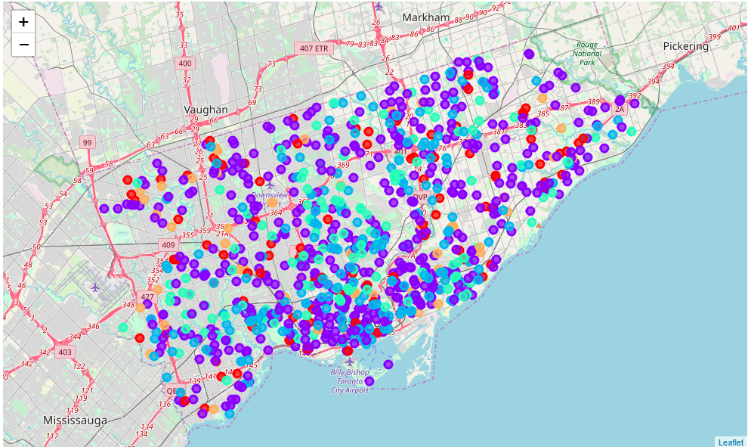
Cluster Labels | loc_id | ward | Infant | Toddler | Preschooler | Kindergarten | Gradelevel | Total | gc_geoid longitude | l
0 | 3634.436170 | 24.425532 | 6.585106 | 14.776596 | 30.457447 | 6.510638 | 16.787234 | 75.117021 | 6.113415e+06 ⁻ 43. 79.372614
1 | 5619.293233 | 22.939850 | 3.240602 | 8.624060 | 19.552632 | 19.746241 | 30.009398 | 81.172932 | 5.761008e+06 ⁻ | 43.
2 | 10873.601036 | 22.222798 | 3.720207 | 12.321244 | 29.419689 | 3.362694 | 4.150259 | 52.974093 | 6.456575e+06 ⁻ 43. 79.393549
3 | 9816.553957 | 21.338129 | 0.503597 | 6.705036 | 23.482014 | 2.913669 | 8.618705 | 42.223022 | 6.400810e+06 ⁻ | 43.
4 | 3204.660377 | 22.603774 | 6.754717 | 11.415094 | 18.264151 | 6.415094 | 7.377358 | 50.226415 | 7.565874e+06 ⁻ | 43.
79.391281
79.399636
79.392709
In [65]
# crea
Out[65]
:
te map
:
In [75]:
# Lets just take portion of dataframe where Boroughs is having least number of care centers (197) that is Scarborough.
(199, 28)
Out[75]:
loc_id
name
type
str_no
street
postal_code
ward
phone
building.type
bldgname Infant Toddler
0 1015
Cardinal Leger Child Care Centre (Scarborough)
Non-Profit 600 morrish rd M1C 4Y1 44 ⁴¹⁶⁻²⁸⁷⁻
0578
Catholic Elementary
School
Cardinal Leger Catholic School
0
10
1 1017
Woodland Nursery School
Non-Profit
1
firvalley
crt
M1L 1N8
35
416-694-
1138x151
High Rise Apartment
NaN
0
10
Centennial College
progress
416-289-
Community
Centennial College Of

Slide 15
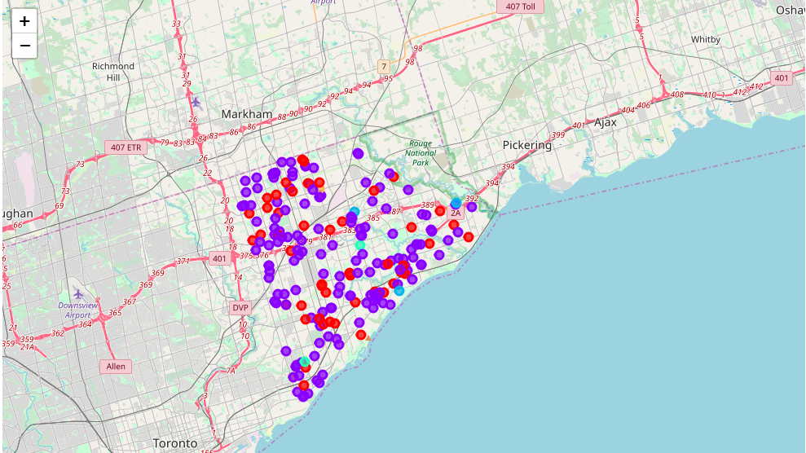
2 1021 Progress
loc_id CampusnCahmilde
Care ...
Non-Profit
type
941
str_no
ave
M1G 3T8
³⁸ 5000x2110 College/University
Applied 10 20 bldgAnratsm&e Infant Toddler Technology
street postal_code
ward phone building.type
3 1031
Cedarbrae Day Nurseries
(20
Greencrest)
Commercial
₂₀ greencrest
M1G 1B8
43
416-431-
2504
High Rise Apartment
Greencrest Property
0
0
circt
4 1045
Children's Village #1 Day Care Centre
Commercial
₁₀₅₀ markham 416-438-
_{rd} M1H 2Y7 38 ₃₃₅₅
High Rise Apartment
NaN 10
10
In [76]
# Re-c
:
reate the map with new markers
:
for scarborough Neighborhoods.
Out[76]
Now, let's use foursquare api query url, search child care center on all boroughs
In [77]:
# The following function retrieves the care center given the names and coordinates and stores it i nto dataframe.
Retrieve all centers and nearby venues given the Addresses
In [79]:
# lets Check size of resulting dataframe
(1777, 7)
Out[79]:
care_center
care_center
care_center
Venue
Venue
Venue
Venue
Latitude | Longitude | Latitude | Longitude | Category
₀ Cardinal Leger Child Care Centre _{43.793104} | -79.175711 Highland Creek | 43.790281 | -79.173703 | Neighborhood
Cardinal Leger Child Care Centre | Sunshine Variety & |  |  | Convenience
(Scarborough)

Slide 16
1
(Scarborough)
care_center
43.793104
care_center
-79.175711
care_center
Video
Venue
43.794723
Venue
-79.174988
Venue
Store
Venue
Cardinal | Leger | Child Care Centre | Latitude | Longitude | Kraftsman | Kabinets | Latitude | Longitude | Category
2 | (Scarborough) |  | 43.793104 | -79.175711 | Inc. |  | 43.793929 | -79.179604 | Home Service
3
Cardinal Leger Child Care Centre
(Scarborough)
43.793104 -79.175711 Morrish Pharmacy 43.790225 -79.174382 Pharmacy
4 Woodland Nursery School 43.702952 -79.281029 Starbucks 43.703634 -79.277661 Coffee Shop
In [80]:
#Count of venues were returned for each Borough
Out[80]:
care_center
care_center _{Venue}
Venue
Venue
Venue
Latitude care_center | Longitude |  | Latitude | Longitude | Category
A & A Child Care Centre 19 | 19 | 19 | 19 | 19 | 19
Abacus Day Care Centre (629735 Ontario ₃₂ | 32 | 32 | 32 | 32 | 32
Absorbent Minds 15 | 15 | 15 | 15 | 15 | 15
Absorbent Minds 2 12 | 12 | 12 | 12 | 12 | 12
After Four Children's Enrichment ₄ | 4 | 4 | 4 | 4 | 4
Inc.)
Program
In [81]:
#lets see how many venues were returned by Foursquare?
There are 162 uniques categories.
Analyze Each Center
In [82]:
# one hot encoding
Out[82]:
care_center
African
Arts
American &
Asian Athletics
Auto
Auto Automotive BBQ Badminton
Bakery Ba
Restaurant | Restaurant | Crafts Store | Restaurant | & Sports | Dealership | Garage | Shop | Joint | Court
Cardinal ₀ Leger Child ₀ (Scarborough) | 0 | 0 | 0 | 0 | 0 | 0 | 0 | 0 | 0 | 0
Cardinal ₁ Leger Child ₀ (Scarborough) | 0 | 0 | 0 | 0 | 0 | 0 | 0 | 0 | 0 | 0
Cardinal ₂ Leger Child ₀ (Scarborough) | 0 | 0 | 0 | 0 | 0 | 0 | 0 | 0 | 0 | 0
Cardinal ₃ Leger Child ₀ | 0 | 0 | 0 | 0 | 0 | 0 | 0 | 0 | 0 | 0
Care Centre
Care Centre
Care Centre
Care Centre (Scarborough)
Woodland 4 Nursery | 0 | 0 | 0 | 0 | 0 | 0 | 0 | 0 | 0 | 0 | 0
School
In [83]:
toronto_onehot.shape

Slide 17
Out[83]:
(1777, 163)
In [84]:
Out[84]:
care_center
African American Restaurant Restaurant
Arts & Crafts Store
Asian Restaurant
Athletics & Sports
Auto Dealership
Auto Garage
Automotive
Shop
BBQ
Joint
Badminton
Court
Bakery
0
A & A Child Care Centre
0.0 0.00000 0.0 0.000000
0.0
0.0
0.0 0.000000 0.052632
0.0 0.052632
Abacus Day
(629735
₁ Care Centre _{0.0} Ontario Inc.) | 0.03125 | 0.0 | 0.000000 | 0.0 | 0.0 | 0.0 | 0.000000 | 0.000000 | 0.0 | 0.031250
₂ Absorbent _{0.0} | 0.00000 | 0.0 | 0.066667 | 0.0 | 0.0 | 0.0 | 0.066667 | 0.000000 | 0.0 | 0.000000
₃ Absorbent _{0.0} | 0.00000 | 0.0 | 0.083333 | 0.0 | 0.0 | 0.0 | 0.083333 | 0.000000 | 0.0 | 0.000000
After Four ₄ Children's _{0.0} | 0.00000 | 0.0 | 0.000000 | 0.0 | 0.0 | 0.0 | 0.000000 | 0.000000 | 0.0 | 0.000000
Program
Minds
Minds 2
Enrichment
In [85]:
# Check new size:
toronto_grouped.shape
Out[85]:
(193, 163)
Let's assume that you are staying at the 5600 Sheppard Ave E, Scarborough, Canada. So let's start by converting the address to its latitude and longitude coordinates.
In [87]:
address = '5600 Sheppard Ave E, Scarborough, Canada'
43.794924 -79.2364314148795
Now, let's assume that you are searching for Day care centers for you children around your address. So, let's define a query to search for Day care centers that is within 20000 metres from your address.
In [88]:
search_query = 'child care center' radius = 2500
print(search_query + ' .... OK!')
child care center .... OK!
Define the corresponding URL
Send the GET Request and examine the results

Slide 18
Get relevant part of JSON and transform it into a pandas dataframe
In [92]:
# assign relevant part of JSON to venues
Out[92]:
categories
hasPerk
id location.address location.cc location.city location.country locati
[{'id':
0 '4f4532974b9074f6e4fb0104',
'name': 'D...
False 57c8d67bcd1043c5b04493dc
5600 Sheppard
Ave E
CA Scarborough
Canada
[{'id':
1 '4bf58dd8d48988d198941735',
'name': 'C...
False
4d937f857ac3a35d2958d825
NaN
CA
NaN
Canada
[{'id':
2 '4f4532974b9074f6e4fb0104',
'name': 'D...
False
5841b68aaf5c144c4edaffa9
96 Dunsfold Dr
CA Scarborough
Canada
[{'id':
3 '4f4532974b9074f6e4fb0104',
'name': 'D...
False
5bc82090cf72a0002cb19198
61 Canmore Blvd
CA Scarborough
Canada
[{'id':
4 '4f4532974b9074f6e4fb0104',
'name': 'D...
False 5bc71981d807ee002ce1ecc6
1965 Brimley
Road
CA Scarborough
Canada
Define information of interest and filter dataframe
In [94]:
# keep only columns that include venue name, and anything that is associated with location
Out[94]:
name
categories address cc city country
5600
Daycare Sheppard CA Scarborough Canada Ave E
distance
formattedAddress labeledLatLngs
lat
ln
Sheppard
0 Square Child Care
62
[5600 Sheppard
Ave E, [{'label': 'display', 'lat': Scarborough ON 43.794412, 'lng':...
M1B 2L4, ...
43.794412
79.23612
1
Centennial College Child Care
Centre
College Academic Building
NaN CA
NaN Canada
1335
[Canada]
[{'label': 'display', 'lat':
43.786091, 'lng':...
43.786091
79.22518
Precious Gems
2 Christian Home Child
Care
96
Daycare Dunsfold
Dr
CA Scarborough Canada
[96 Dunsfold Dr,
2275 Scarborough ON M1B 1T6, Canada]
[{'label': 'display', 'lat':
43.814607, 'lng':...
43.814607
79.22878
3
Scarborough
Morrish YMCA Child Care Centre
Daycare
61
Canmore
Blvd
CA Scarborough Canada
2145
[61 Canmore Blvd, Scarborough ON M1C 4B2, Canada]
[{'label': 'display', 'lat': 43.79792960255199...
43.797930
79.26281
Scarborough
CD
4 Farquharson YMCA Child Care Centre
Daycare
1965
Brimley CA Scarborough Canada Road
2651
[1965 Brimley
Road, [{'label': 'display', 'lat': Scarborough ON 43.78459599857809...
M1S 2B1, Ca...
43.784596
79.26616
Toronto Scarborough
5 Town Centre
Ct YMCA
Child ...
Child Care
Service
230
Town Center Court
CA Scarborough Canada
2665
[230 Town Center
Court, Scarborough ON
M1P 4Y7...
[{'label': 'display', 'lat': 43.77479523565078...
43.774795
79.25438
Let's visualize child care centers that are nearby

Slide 19
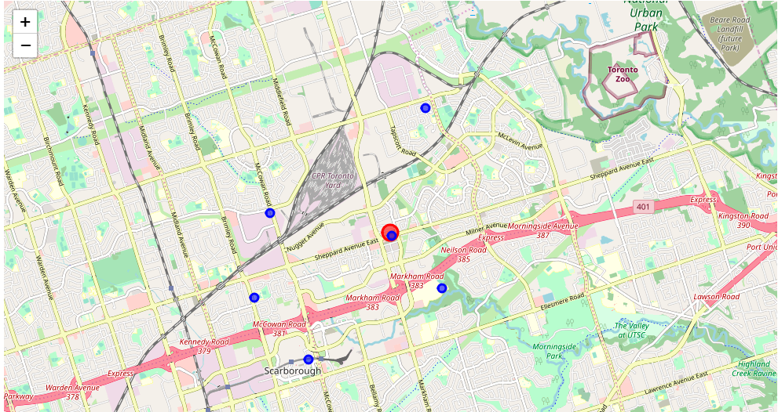
In [95]:
dataframe_filtered.name
Out[95]:
0
1
2
3
Sheppard Square Child Care Centennial College Child Care Centre Precious Gems Christian Home Child Care Scarborough Morrish YMCA Child Care Centre
4
5
Scarborough CD Farquharson YMCA Child Care Centre Toronto Scarborough Town Centre Ct YMCA Child ...
Name: name, dtype: object
In [96]:
# generate map centred around your location # display map
center_map
Out[96]:
Now you can explore each child center around your address.
In [98]:
dict_keys(['id', 'name', 'contact', 'location', 'canonicalUrl', 'categories', 'verified', 'stats', 'url', 'likes', 'dislike', 'ok', 'venueRatingBlacklisted', 'allowMenuUrlEdit', 'beenHere', 'specials', 'photos', 'reasons', 'description', 'hereNow', 'createdAt', 'tips', 'shortUrl', 'timeZone', 'listed', 'hours', 'pageUpdates', 'inbox', 'attributes', 'bestPhoto'])
Out[98]:
{'id': '5841b68aaf5c144c4edaffa9',
'name': 'Precious Gems Christian Home Child Care',
'contact': {'phone': '4163350469', 'formattedPhone': '(416) 335-0469'}, 'location': {'address': '96 Dunsfold Dr',
'lat': 43.814607,
'lng': -79.228787,
'labeledLatLngs': [{'label': 'display', 'lat': 43.814607,

Slide 20
6. Results and Discussion
This section provides some insights on how the effectiveness of the fee subsidy program is related to the number of child care centres across districts and centre types. First, I aim to visualize the aspects of child care centres for the City of Toronto. I use bar charts to visualize the data.
From the bar chart, we see that the dataset can be briefly analyzed as the following:
This report analyzes 1007 child care centres in Toronto as follows:
1.Based on center type we have the following;
A. 668 centers are Non-Profit. (530 have Fee-Subsidy)
B. 286 centers are Commercial. (Only 94 have Fee-Subsidy)
C. 53 centers are city operated. (All have Fee-Subsidy)
2. Based on Fee-Subsidy program we have: 677 centers are accepting Fee-subsidy.
A. 330 centers are not having Fee-subsidy program.
3. Based on center Location:
A. 318 centers are located in Toronto East York.
B. 266 centers are located in North York.
C. 226 centers are located in Etobicoke York.
D. 197 cenetrs are located in Scarborough.
4. Total number of enrolled children in this report is = 68763 ranged from Infant-Toddler Preschooler-Kindergarten-Gradelevel.
Children are distributed based on the type of the care centers as follows:
48871 (71% from total children) are enrolled in Non-Profit centers.
17230 (25% from total children) are enrolled in Commercial centers.
2662 (4% from total children) are enrolled in city-operated centers.
5. clustering was applied to the data set based on the above categories. 5 clusters labels were in the range [0,1,2,3,4] as follows:
0: color = Red, commercial centers with fee-subsidy.
1: color = Purple, Non-Profit centers with fee-subsidy.
2: color = Blue, commercial centers with no fee-subsidy.
3: color = Green, Non-Profit centers with no fee-subsidy.
4: color = Yellow, City operated centers with fee-subsidy.
7. Conclusion
Investigating the effectiveness of fee subsidy program is multidimensional. It is related to the data on the details of fee subsidy applications in the City of Toronto as well as the fee subsidy policy of child care centres and how many spaces are reserved for children with fee subsidy in these centres. Furthermore, Census 2016 can be used to uncover some demographic features in each district and their wards. This may help us to see which wards need more child care centres with fee subsidy contract.
THANK YOU

